Slide 1
Software Testing and Quality Assurance
Lecture – 19

Slide 2
Agenda
Dataflow based testing
Requirements based testing

Slide 3
Data-Flow Testing
Data-flow testing uses the control flowgraph to explore the unreasonable things that can happen to data (i.e., anomalies).
Consideration of data-flow anomalies leads to test path selection strategies that fill the gaps between complete path testing and branch or statement testing.

Slide 4
Data-Flow Testing (Cont’d)
Data-flow testing is the name given to a family of test strategies based on selecting paths through the program’s control flow in order to explore sequences of events related to the status of data objects.
E.g., Pick enough paths to assure that:
Every data object has been initialized prior to its use.
All defined objects have been used at least once.

Slide 5
Data Object Categories
(d) Defined, Created, Initialized
(k) Killed, Undefined, Released
(u) Used:
(c) Used in a calculation
(p) Used in a predicate

Slide 6
(d), (u) and (k)
An object (e.g., variable) is defined (d) when it:
appears in a data declaration
is assigned a new value
is a file that has been opened
is dynamically allocated, etc.
An object is killed when it is:
released (e.g., free) or otherwise made unavailable (e.g., out of scope)
a loop control variable when the loop exits
a file that has been closed
An object is used when it is part of a computation or a predicate.
A variable is used for a computation (c) when it appears on the RHS (sometimes even the LHS in case of array indices) of an assignment statement.
A variable is used in a predicate (p) when it appears directly in that predicate.

Slide 7
Example: Definition and Uses
What are the definitions and uses for the program below?
1. read (x, y);
2. z = x + 2;
3. if (z < y)
4 w = x + 1;
else
5. y = y + 1;
6. print (x, y, w, z);

Slide 8
Example: Definition and Uses
Def C-use
P-use
1. | read (x, y); | x, y
2. | z = x + 2; | z | x
3. 4 5. | if (z < y) w = x + 1; else y = y + 1; | w y | x y | z, y
6. | print (x, y, w, z); |  | x, y,
w, z

Slide 9
Data-Flow Anomalies
A data-flow anomaly is denoted by a two character sequence of actions. E.g.,
ku: Means that an object is killed and then used.
dd: Means that an object is defined twice without
an intervening usage.

Slide 10
Two Letter Combinations for
d k u
dd: Probably harmless, but suspicious.
dk: Probably a bug.
du: Normal situation.
kd: Normal situation.
kk: Harmless, but probably a bug.
ku: Definitely a bug.
ud: Normal situation (reassignment).
uk: Normal situation.
uu: Normal situation.

Slide 11
Single Letter Situations
A leading dash means that nothing of interest (d, k, u) occurs prior to the action noted along the entry-exit path of interest.
A trailing dash means that nothing of interest happens after the point of action until the exit.

Slide 12
Single Letter Situations
-k: Possibly anomalous:
Killing a variable that does not exist.
Killing a variable that is global.
-d: Normal situation.
-u: Possibly anomalous, unless variable is global.
k-: Normal situation.
d-: Possibly anomalous, unless variable is global.
u-: Normal situation.

Slide 13
Dataflow anomalies
Anomaly: It is an abnormal way of doing something.
Example 1: The second definition of x overrides the first.
x = f1(y);
x = f2(z);
Three types of abnormal situations with using variable.
Type 1: Defined and then defined again
Type 2: Undefined but referenced
Type 3: Defined but not referenced

Slide 14
Dataflow anomalies
Type 1: Defined and then defined again (Example 1 above)
Four interpretations of Example 1
The first statement is redundant.
The first statement has a fault -- the intended one might be: w = f1(y).
The second statement has a fault – the intended one might be: v = f2(z).
There is a missing statement in between the two: v = f3(x).
Note: It is for the programmer to make the desired interpretation.
Type 2: Undefined but referenced
Example: x = x – y – w; /* w has not been defined by the programmer. */
Two interpretations
The programmer made a mistake in using w.
The programmer wants to use the compiler assigned value of w.
Type 3: Defined but not referenced
Example: Consider x = f(x, y). If x is not used subsequently, we have a Type 3 anomaly.

Slide 15
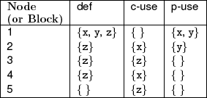
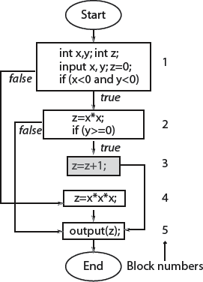
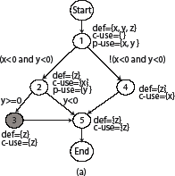
Data flow graph: Example
Unreachable node

Slide 16
Def-clear path
Any path starting from a node at which variable x is defined and ending at a node at which x is used, without redefining x anywhere else along the path, is a def-clear path for x.
Path 2-5 is def-clear for variable z defined at node 2 and used at node 5. Path 1-2-5 is NOT def-clear for variable z defined at node 1 and used at node 5.
Thus definition of z at node 2 is live at node 5 while that at node 1 is not live at node 5.

Slide 17
Def-use pairs
Def of a variable at line l₁ and its use at line l₂ constitute a def-use pair. l₁ and l₂ can be the same.
dcu (di(x)) denotes the set of all nodes where di(x)) is live and used.
dpu (di(x)) denotes the set of all edges (k, l) such that there is a def-clear path from node i to edge (k, l) and x is used at node k.
We say that a def-use pair (d_{i}(x), u_{j}(x)) is covered when a def-clear path that includes nodes i to node j is executed. If u_{j}(x)) is a p-use then all edges of the kind (j, k) must also be taken during some executions.

